Slide 1
Domains & Email
Engage with existing customers, promote products and drive traffic.

Slide 2
Agenda
1
2
3
4
Importance of Domains/emails
Domains and Emails
Features & Benefits Overview
Addressing Common Concerns

Slide 3

Domain and email are key to building trust and rapport
Domain and email help customers get to know a business and start to build trust. Receiving emails from an email address that includes the company name inspires trust and confidence.
A domain is a building block for a website and email, it’s a great way to start building rapport with customers as they begin to associate the domain with your company. It’s also a great way to differentiate a business from the competition.
As per local Mailbird, 2022
75%
Of consumers say professional email addresses are key to trust.

Slide 4
Cost of not connecting with customers
Lack of Brand Recognition
Customers won’t recognize the brand name if businesses are contacting them using generic email addresses (e.g., @gmail.com, @yahoo.com).
Lack of Credibility & Trust
Personalized domain and email adds credibility to business by displaying that the business have invested in online presence.
Potential Security Risks
By neglecting personalized domain and email services, business may be more susceptible to security breaches and phishing attempts, potentially compromising sensitive business information.
Lack of Customer Engagement
Using generic email often result in emails being flagged as spam or having lower deliverability rates. This affect the ability to reach customers, respond to inquiries, and maintain effective communication.

Slide 5
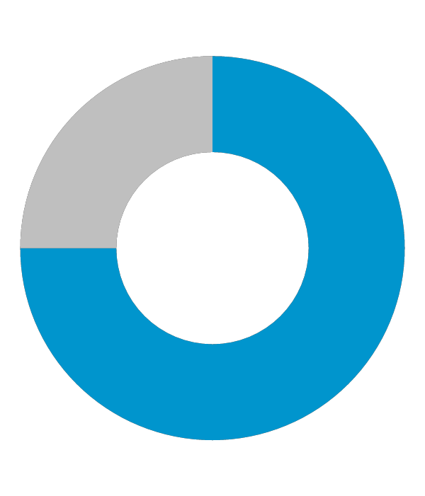
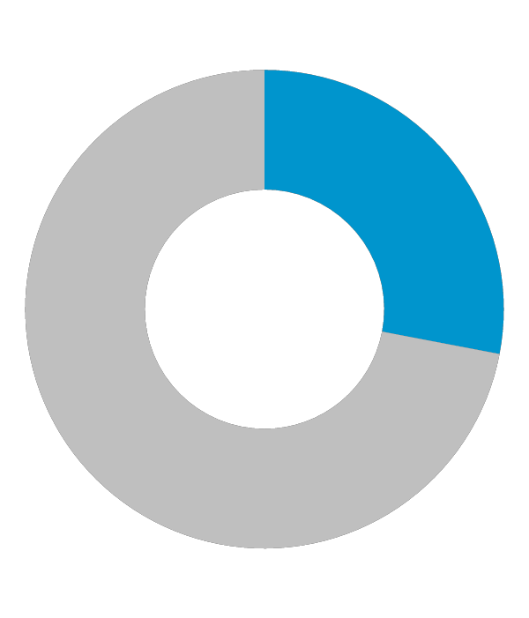
Impact of a domain and email
60%
42%
64%
of businesses that switched to a custom domain-based email saw an increase in customer engagement
Privy
Of businesses that switched to domain-based email saw an increase in sales
Privy
Of small business use email marketing to reach customers
Hubspot

Slide 6

Domains + Email
Establish brand identity
Build trust
Look professional
Improve Productivity
Easy management

Slide 7

Custom Addresses and easy management
Businesses have professional representation with an email address that matches their business domain name. It promotes the brand and helps them stand out from the competition.
Manage domain settings in an easy-to-use online interface.

Slide 8
Domain Features
Domain forwarding
Available as an add on. Having multiple domains forwarded to one increases traffic on the main website
Technical Support
Technical support can assist with any issues that arise.
Simple Transfers
Transfer an existing domain for cost savings easily.
Easy Management
Manage domain settings in an easy-to-use online interface.

Slide 9
Email Features
Calendaring
Managing calendars is easy, share calendars, create events, set free/ busy hours.
Security
Spam filter with light, standard and aggressive options. Trusted senders allow users to add senders to the list so their emails will always go to the inbox regardless of spam settings. Spam senders allows users to choose senders they will never receive emails from regardless of spam settings.
Task boxes
Turn email into categories, assign tasks, set reminders and add due dates to emails.
Ad Free
Webmail is completely ad free. Stay focused on work and don’t get distracted by ads.

Slide 10
How it works

Slide 11
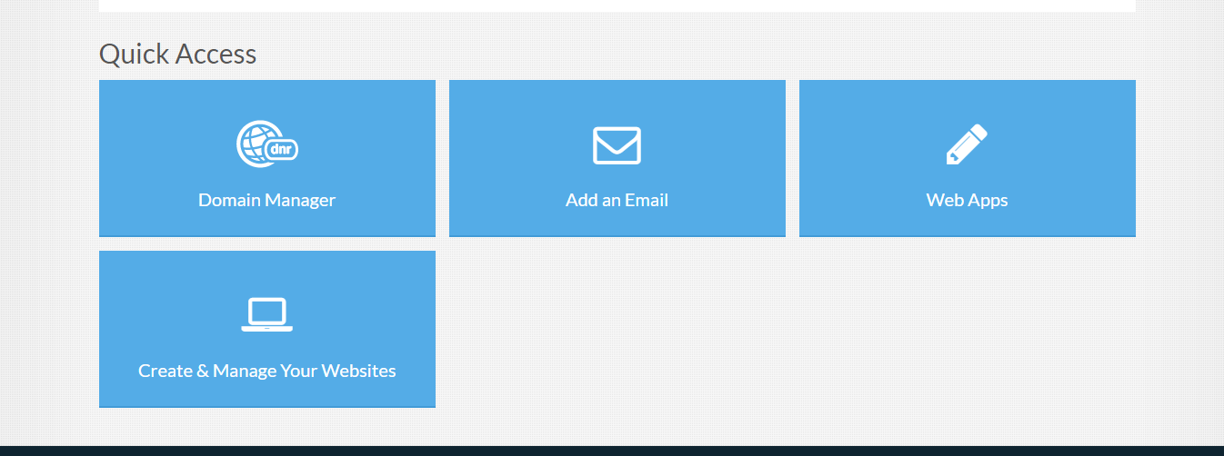
Login to your portal and access both domain manager and add an email
You are able to manage the domain and emails right from the portal.
Use domain manager to view domain status, expiration date, auto-renewal and to update name servers.
Click add an email to create a new email address and set up email configurations with IMAP/ POP/ Webmail, see mailbox usage and adjust spam settings.

Slide 12
Benefits
Contacting customers through a custom domain and branded email builds trust because businesses are contacting them as a corporate entity.
Build trust
Establish brand identity
A domain and branded email gives customers a way to find a business online. Using the business name they can go to the website, social and reviews to learn more about the business.
Using domain-based email instead of Google or Microsoft adds a layer of professionalism because the communication is coming from a business.
Look professional
Multiple inboxes allows businesses to manage all email accounts in one place. Task box allows for emails to be turned into tasks with set due dates.
Improve productivity

Slide 13
Q & A / Next steps

Slide 14
Frequently Asked Questions

Slide 15
What is a domain?
A domain name is an address that potential customers use to find your website. It will also be used to create business email addresses.
2. Do I own the domain or do you?
You own the domain. We register it and make sure you have access to the domain to set up a website, forwarding, mail etc.
3. What is domain-based email?
Domain-based email is an email address ending in your domain name i.e. sales@domain.com. This email will represent your brand every time you contact your customer and keep your business top of mind.
4. I have a customer whose emails keep going to spam. How do I ensure I always receive their messages?
I understand it can be frustrating when you are waiting on an email and it gets sent to spam. The easiest way to ensure you receive all emails from a particular email address would be to add their email to the trusted senders list. This will let their emails through to your mailbox regardless of spam settings.

Slide 16
Probing Questions

Slide 17
I noticed you don’t have domain-based email. You should be promoting your business instead of Google and Microsoft. Why haven’t you made the switch yet?
Having a domain is the best way to start building your brand. Customers will see your business name at the end of your email address and begin to associate it with you and your business.
How much are you paying for Google Workspace or Microsoft 365?
These costs add up and they bundle a lot in their plans that many people don’t use or need. Our solution is cost effective and efficient.
Do you currently own a domain name?
Having a domain is the best way to start building your brand.
Do you have control over your domain? Access to a tool to modify your domain settings?
With our domain manager you have complete control over your domain. You can access tools to modify your settings and set up forwarding, mail and more.

Slide 18
Objection Handlers

Slide 19
I don’t need a domain name now; I can get one later
Are you aware that domains are first come, first serve? A domain that is available now is not guaranteed to be available in the future.
I don’t want a website.
A domain is not the same as a website. Many business owners register multiple domain names (different spelling or different domain extensions) to protect the brand ensure no other businesses can register the name.
I don’t want a new email, I’d rather use my personal.
Having a domain-based email makes you look more credible as a business and builds trust with your customers.
We don’t have the time.
The email system is easy to set up and use. You can add and remove emails with ease, manage your calendar and create a customized experience all from your email portal. Having a web-based email solution means you can access your email from anywhere that has an internet connection.

Slide 20
Test your Knowledge

Slide 21
1. What percentage of customers say professional emails are key to trust?
A) 50%
B) 34%
C) 75%
D) 80%
2. What can you see in Domain manager?
A) Domain Status
B) Expiration date
C) Both A and B
D) New domains that are available
3. True or False: Domain and email establish brand identity.
A) True
B) False
4. What are benefits of domain-based email?
A) Build trust
B) Establish brand identity
C) Look professional
D) All of the above
5. What does the security email feature allow customers to do?
A) Set spam settings
B) Choose trusted senders
C) Choose spam senders
D) All of the above
6. What does task box allow customers to do?
A) Turn emails into categories
B) Assign tasks
C) Add due dates to emails
D) All of the above
7. True or False: Email is easy to set up and use
A) True
B) False
8. Which are key features of email?
A) Calendaring
B) Security
C) Task Boxes
D) All of the above
9. Which are key features of domains?
A) Technical Support
B) Simple Transfers
C) Easy Management
D) All of the above
10. True or False: Domains are first come first serve.
True
False

Slide 22
Correct Answers
C) 75%
C) Both A and B
A) True
D) All of the above
D) All of the above
D) All of the above
A) True
D) All of the above
D) All of the Above
A) True

